Slide 1

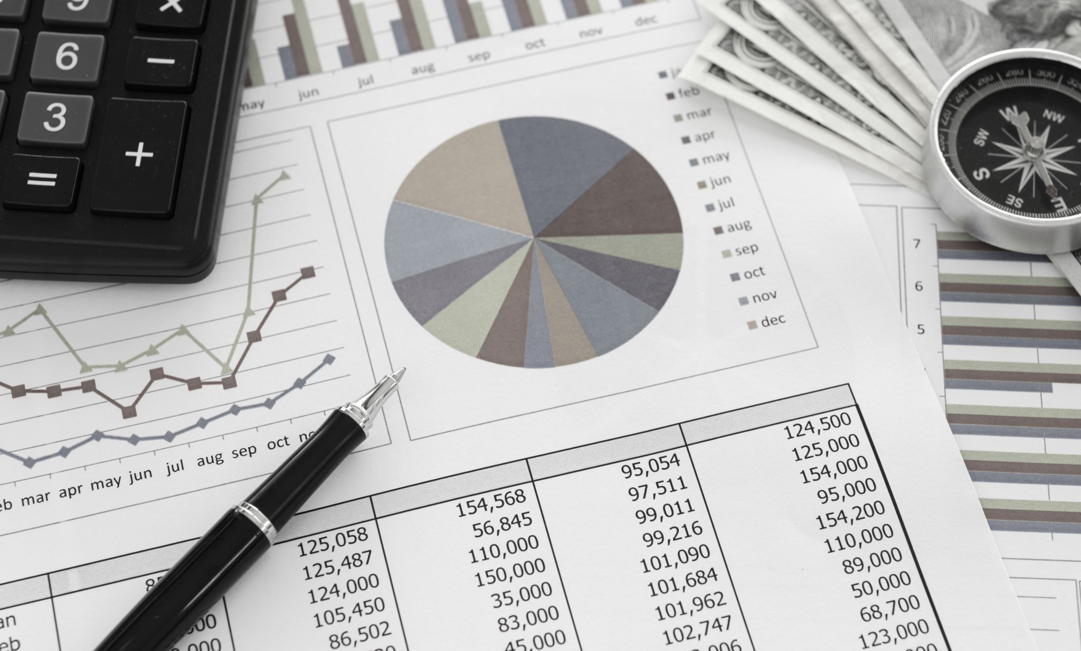
Home Loan Status Prediction
This Photo by Unknown author is licensed under CC BY-ND.

Slide 2



Understanding Problem statement
Housing Finance company deals in all kinds of home loans.
Deals across all urban ,semi urban and rural areas.
Customer first applies for a home loan.
Company validates the customer eligibility for the loan.

Slide 3
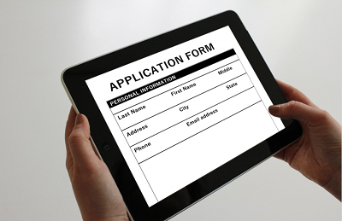
Filling Online Application
Company wants to automate the loan eligibility process.
Gender, Marital Status
Education
No. of Dependents income
This Photo by Unknown author is licensed under CC BY-NC.

Slide 4

Objective -Automate Process of Home loan Status
Provided a dataset to identify the customer segments that are eligible for loan amounts.
01
Find the hidden trends and Pattern and build a Robust Model.
02
Trends and Patterns can be used for Predicting the Loan status of the candidates.
03

Slide 5
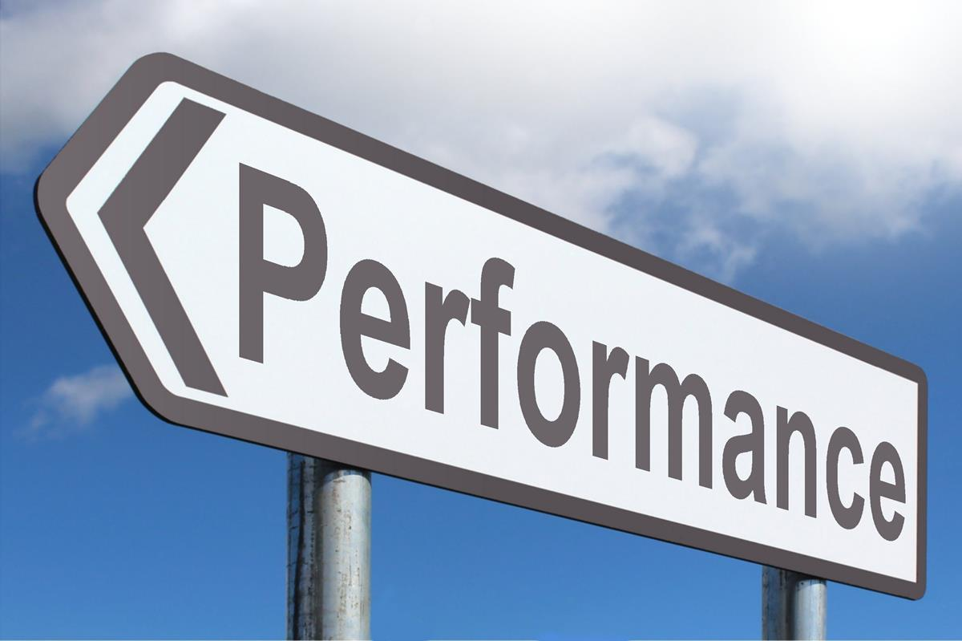
Evaluate Performance of Model
We can use different Performance Metrics such as:
Accuracy
Precision, Recall ,F1 Score
Here ,our aim is to evaluate the models so that we could come up with best model to predict the loan status of the candidates.
This Photo by Unknown author is licensed under CC BY-SA.

Slide 6
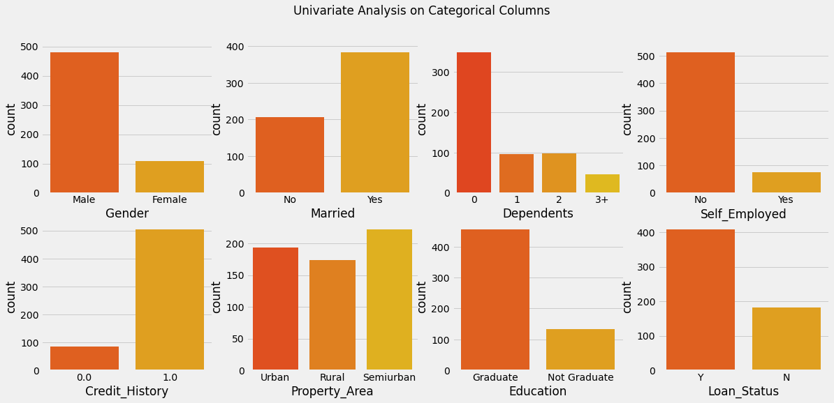
Univariate Data Analysis
Before applying univariate we need to ensure that data is cleaned and outliers are removed.
Univariate is the simplest form of statistical Analysis and involves only one variable.

Slide 7
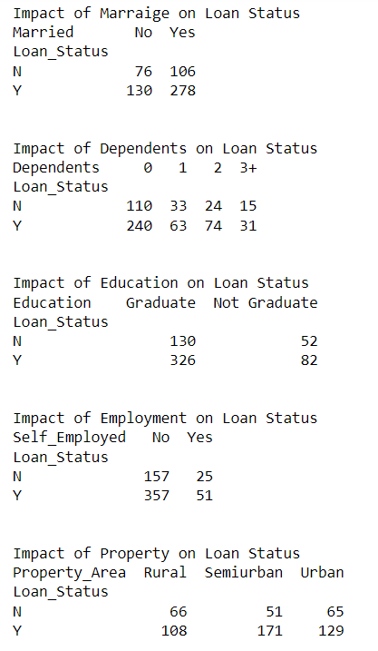

Slide 8

Bivariate Analysis
Bivariate analysis is on of the simplest form of quantitative analysis.
It is helpful in testing hypothesis of association.
There are three types of Bivariate Analysis:
Categorical vs numerical
Categorical vs categorical
Numerical vs numerical

Slide 9
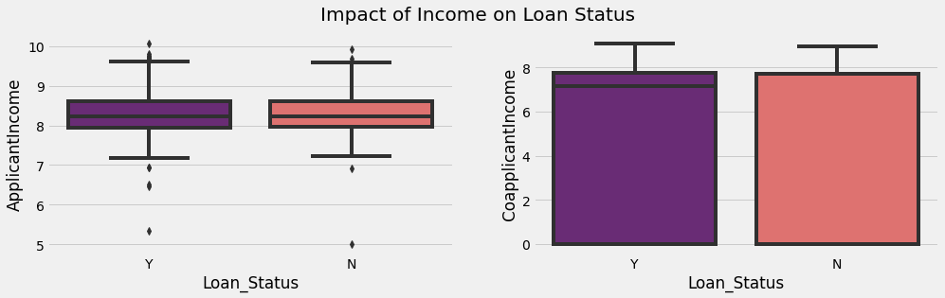
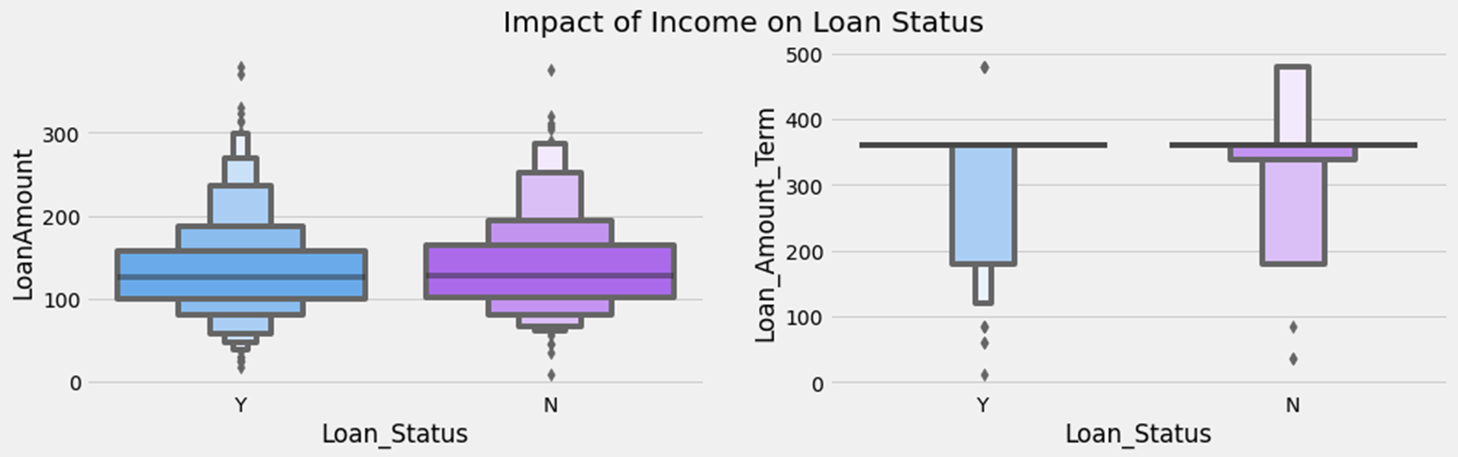

Slide 10
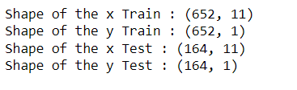
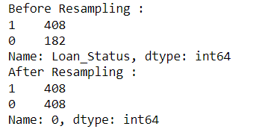
Resampling Technique

Slide 11

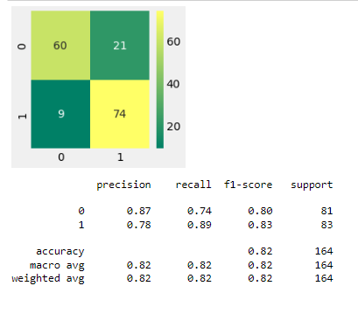
Logistic regression modelling

Slide 12
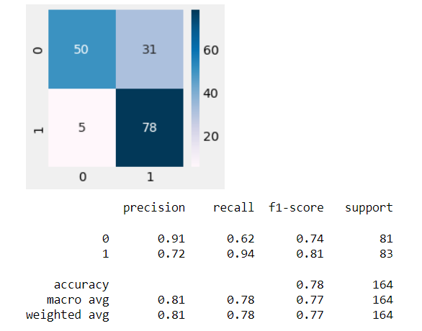


Gradient boosting
cross_val_score

Slide 13
Comparison of Other Model V/S Our Model
OTHERS MODEL | OUR MODEL
Only logistic regression used. | Logistic regression as well as Gradient Boosting.
Less no. of Library Used for visualization. | More No. of Visualization used.
Outcomes are not Clear and Not Easy to Understand. | Better Understanding And Outcomes are easy to Understand.
Multiple Technique Not Used so the Accuracy and Performance are not Best. | Used of Multiple Technique and Multiple Methods helps To improve Accuracy in Performance.

Slide 14

Summary
In the Modelling data:-
Modelled our Data with Logistic Regression and Gradient Boosting.
But Gradient Boosting did a little better as compared to the logistic regression model.
We used Accuracy, Precision and Recall.

Slide 15
Major Takeaways
We need to apply some Resampling Techniques to make it balanced.
We need to apply some Data transformation techniques.
We must perform Univariate and Bivariate Analysis to understand the Better.
Finally, try more and more predictive models,compare them using various evaluation metrics is a good way of finding the best model.

Slide 16

Thank-you!

